Slide 1
CBB Workshop: Introduction to Survival Analysis with Practical Applications in R
Rickard Strandberg & Davide Valentini
Center for Bioinformatics and Biostatistics
2024-03-19

Slide 2
Agenda
1st Session 13:00-14:00
The basics of survival analysis
Coffee Break 14:00-14:30
2nd Session 14:30-16:00
Practical application in R
examples, graphics, and exercises

Slide 3
Introduction to Survival Analysis

Slide 4
Outline
The most important concepts of survival analysis
The type of data we use
The survival function & the cumulative incidence function
The hazard rate function
The Cox proportional hazards regression model

Slide 5
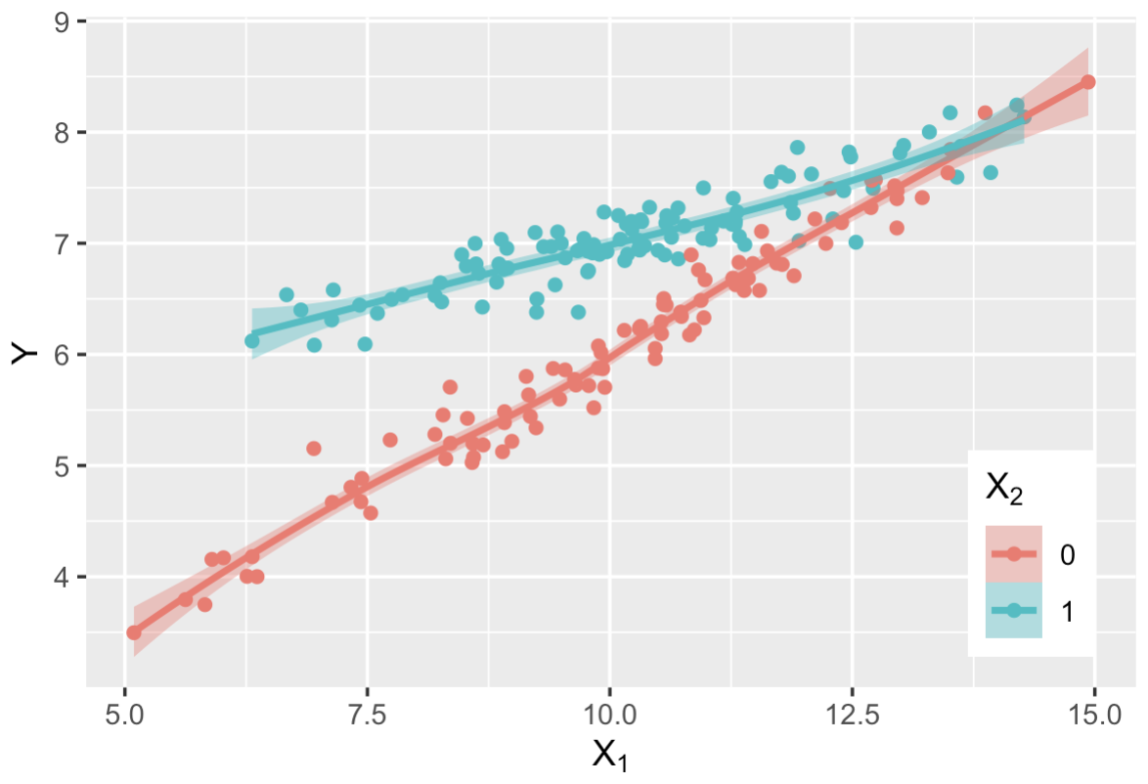

Our Typical Statistical Analysis
$$\hat{Y}=1+0.5X_{1}+4X_{2}−0.3X_{1}X_{2}$$
Typical data & research question relationship:
We measure some Outcome variable (Y)
We measure a set of Covariates (X₁, X₂, …)
Exposure/risk factor variables potentially associated with the outcome
We perform some statistical analysis—Regression Model

Slide 6

What is Survival Analysis?
Survival Analysis is a special family of statistical analysis
The outcome is time
We measure the time until a particular event
Death (Mortality)
Diagnosis of a particular disease (Incidence)
Progression to a stage of disease
etc.

Slide 7
Time-to-Event Data
Time-to-event outcome:
The time duration we followed each subject
Whether or not they experienced the event
◆ Event
◆ No Event
Time

Slide 8
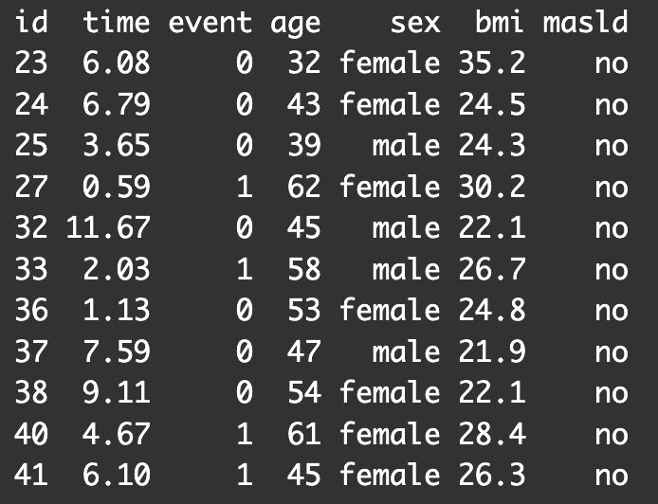
Time-to-Event Data
For example:
Time-to-event outcome:
The time duration we followed each subject
Whether or not they experienced the event
◆ Event
◆ No Event
Time

Slide 9
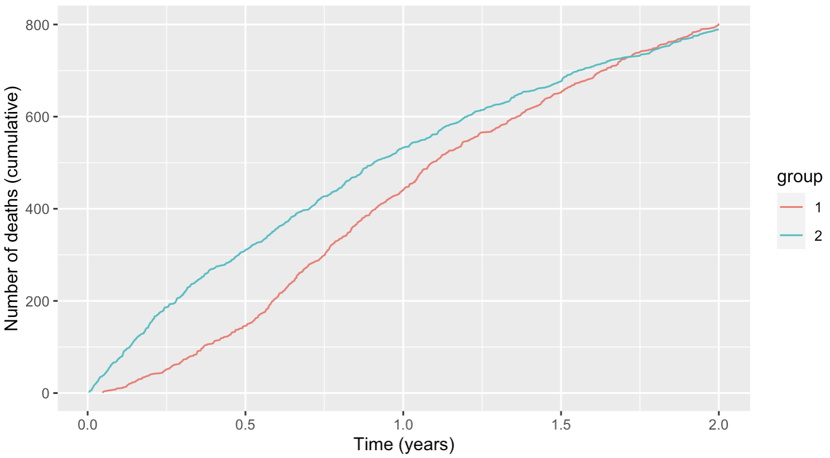
Why two-part outcome?
Can’t we just look at the final outcome?
Example: Mortality over 2 years comparing 2 groups
Not just what happens, but also when
Who experiences more
events and/or events sooner?

Slide 10
Censoring
We don’t observe events for everyone
We end the follow-up at some point
(Given enough time, would everyone have the event?)
“Censored at time t” = event occurs sometime after t
i.e. we didn’t observe it yet
a.k.a. “lost to follow-up”
Time

Slide 11
Censoring
We don’t observe events for everyone
We end the follow-up at some point
(Given enough time, would everyone have the event?)
“Censored at time t” = event occurs sometime after t
i.e. we didn’t observe it yet
a.k.a. “lost to follow-up”
Often due to inclusion/recruitment over time and with a fixed end date
Date

Slide 12
Person-Time
Due to different censoring patterns between patients, it is difficult
Censored observations are still informative.
Example: Cancer recurrence after 5 years (“cancer-free”)

Slide 13
Now What?
We now know how the data is structured
What do we want to know?
In a typical non-survival analysis:
Summary statistics (mean/median, proportions) including
standard errors (confidence intervals)
comparisons between groups (graphically or with statistical tests)
Proper regression model
Mulitvariate model
Effect sizes (mean differences, odds ratios, etc.) and confidence intervals
Statistical tests for association with the outcome

Slide 14
The Survival Function

Slide 15
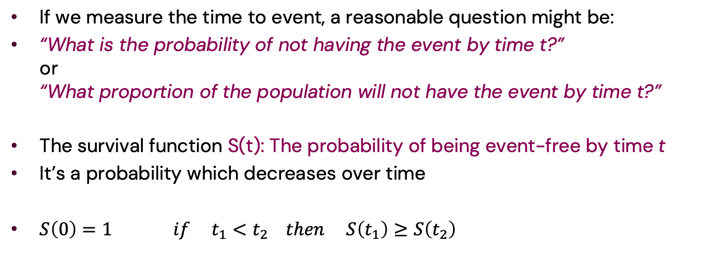
The Survival Function
If we measure the time to event, a reasonable question might be:
“What is the probability of not having the event by time t?” or “What proportion of the population will not have the event by time t?”
The survival function S(t): The probability of being event-free by time t
It’s a probability which decreases over time
$S\left(0\right)=1$ $if t_{1}<t_{2} then S\left(t_{1}\right)≥S\left(t_{2}\right)$

Slide 16
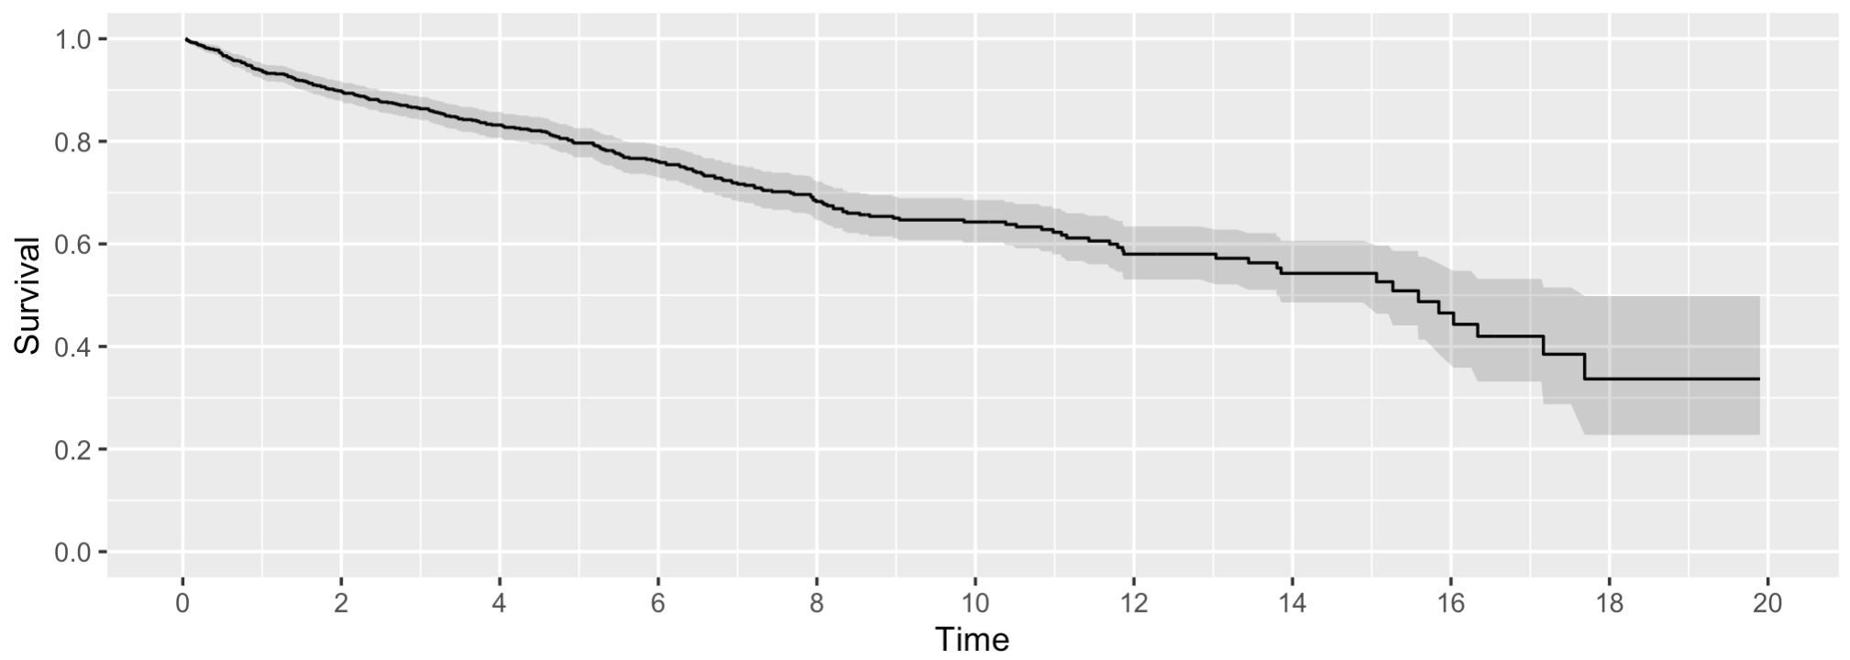
Kaplan-Meier Estimate
Kaplan-Meier estimate of the survival function (with 95% confidence int.)

Slide 17
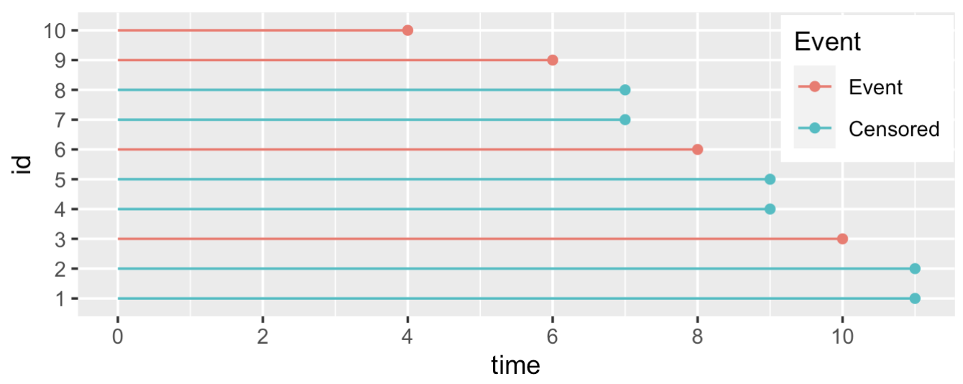
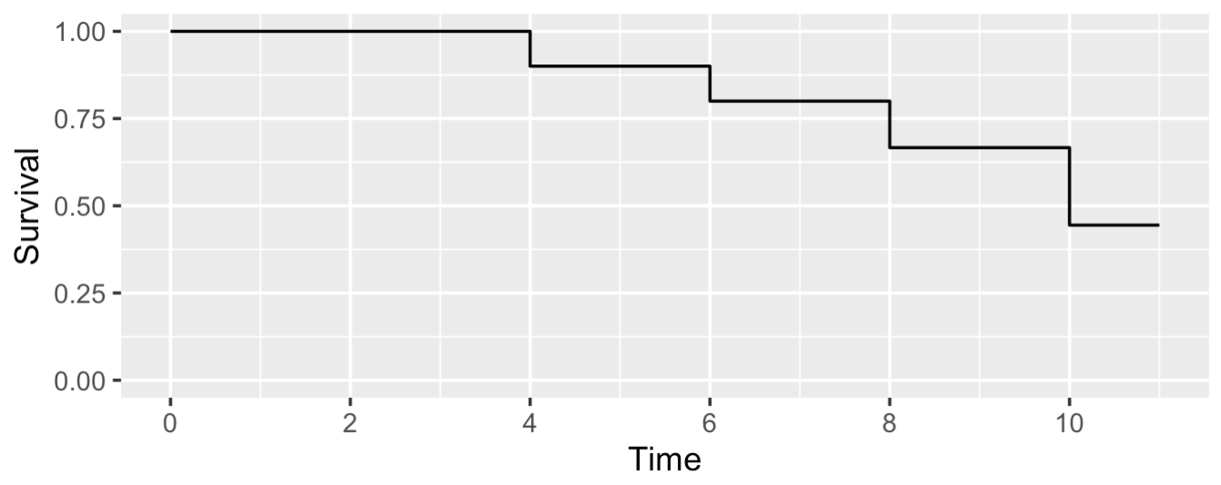
Calculating the Survival Function
Survival calculation:

Slide 18
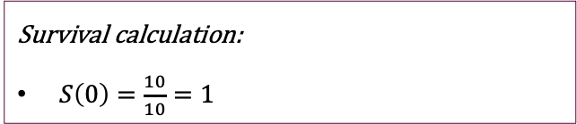
Calculating the Survival Function
Survival calculation:
$S\left(0\right)=\frac{10}{10}=1$

Slide 19
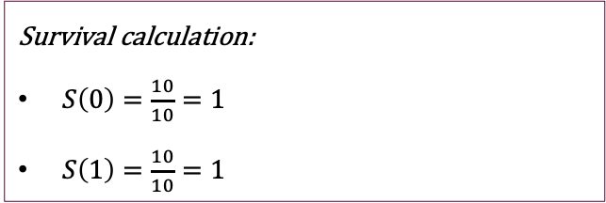
Calculating the Survival Function
Survival calculation:
$S\left(0\right)=\frac{10}{10}=1$
$S\left(1\right)=\frac{10}{10}=1$

Slide 20
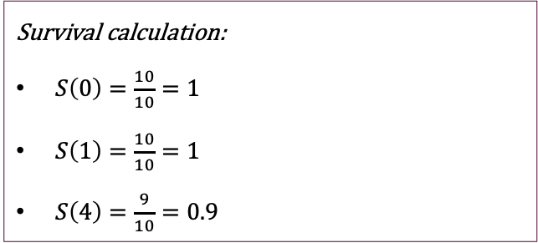
Calculating the Survival Function
Survival calculation:
$S\left(0\right)=\frac{10}{10}=1$
$S\left(1\right)=\frac{10}{10}=1$
$S\left(4\right)=\frac{9}{10}=0.9$

Slide 21
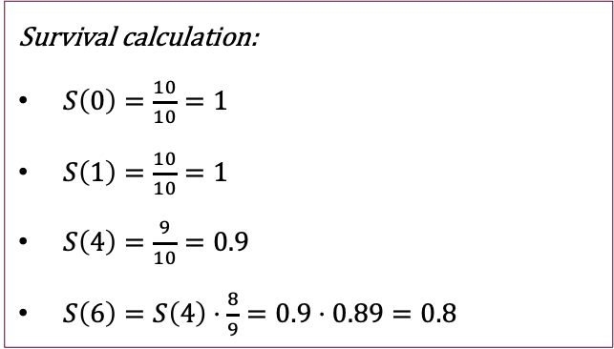
Calculating the Survival Function
Survival calculation:
$S\left(0\right)=\frac{10}{10}=1$
$S\left(1\right)=\frac{10}{10}=1$
$S\left(4\right)=\frac{9}{10}=0.9$
$S\left(6\right)=S\left(4\right)⋅\frac{8}{9}=0.9⋅0.89=0.8$

Slide 22
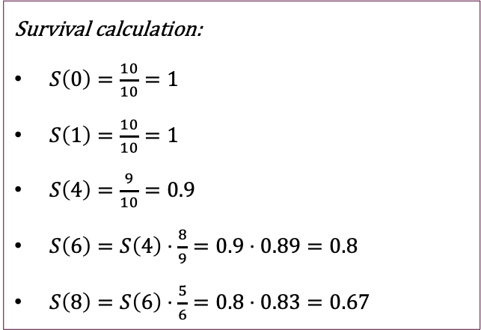
Calculating the Survival Function
Survival calculation:
$S\left(0\right)=\frac{10}{10}=1$
$S\left(1\right)=\frac{10}{10}=1$
$S\left(4\right)=\frac{9}{10}=0.9$
$S\left(6\right)=S\left(4\right)⋅\frac{8}{9}=0.9⋅0.89=0.8$
$S\left(8\right)=S\left(6\right)⋅\frac{5}{6}=0.8⋅0.83=0.67$

Slide 23
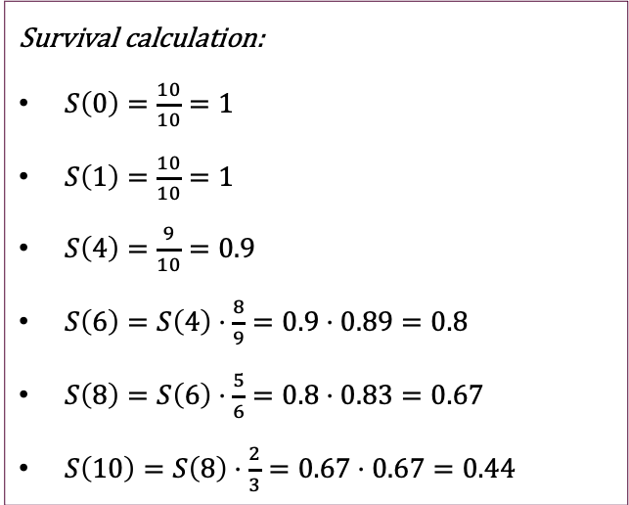
Calculating the Survival Function
Survival calculation:
$S\left(0\right)=\frac{10}{10}=1$
$S\left(1\right)=\frac{10}{10}=1$
$S\left(4\right)=\frac{9}{10}=0.9$
$S\left(6\right)=S\left(4\right)⋅\frac{8}{9}=0.9⋅0.89=0.8$
$S\left(8\right)=S\left(6\right)⋅\frac{5}{6}=0.8⋅0.83=0.67$
$S\left(10\right)=S\left(8\right)⋅\frac{2}{3}=0.67⋅0.67=0.44$

Slide 24
Kaplan-Meier Estimate
Kaplan-Meier estimate of the survival function (with 95% confidence int.)

Slide 25
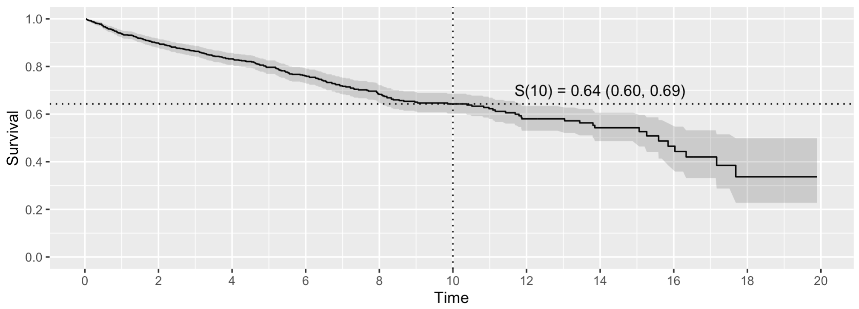
Kaplan-Meier Estimate
Kaplan-Meier estimate of the survival function (with 95% confidence int.)

Slide 26
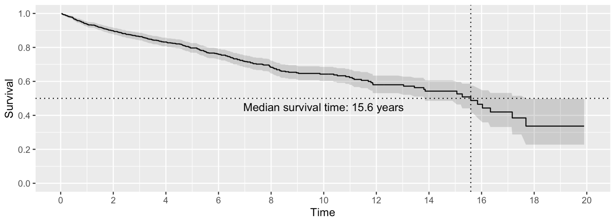
Median survival time
Another interesting statistic could be the Median Survival Time:
The time until 50% have experienced the event.
For which t is S(t)=0.5?

Slide 27
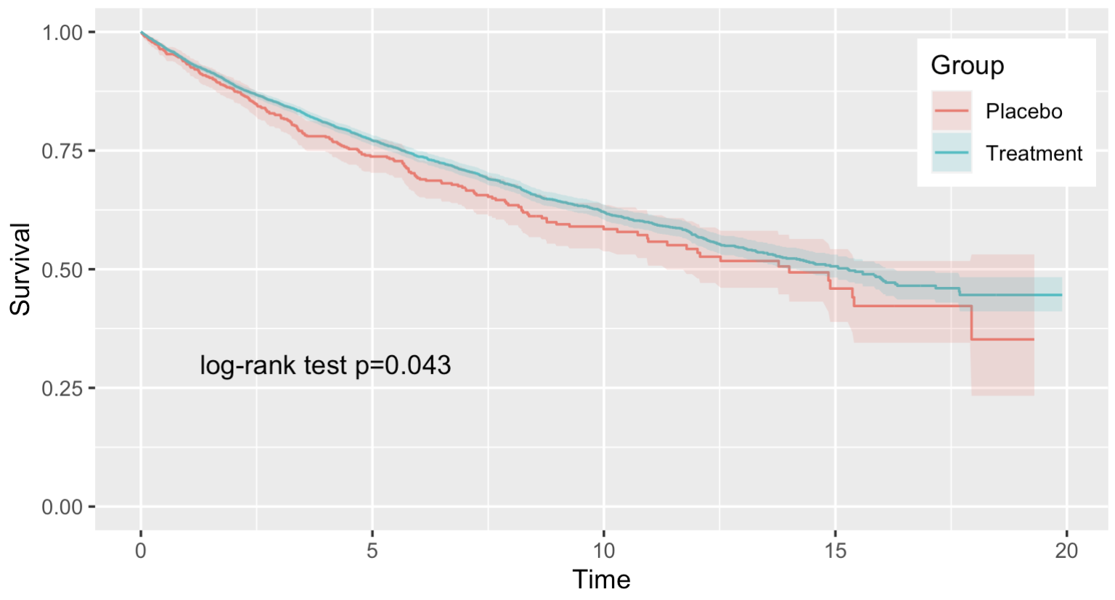
Comparing Survival Curves
We can compare survival curves between groups
We can do as statistical test—the log-rank test–for difference between the curves

Slide 28
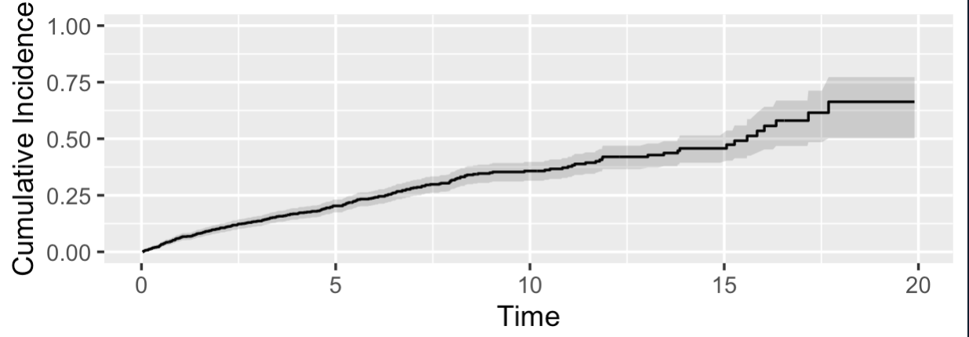
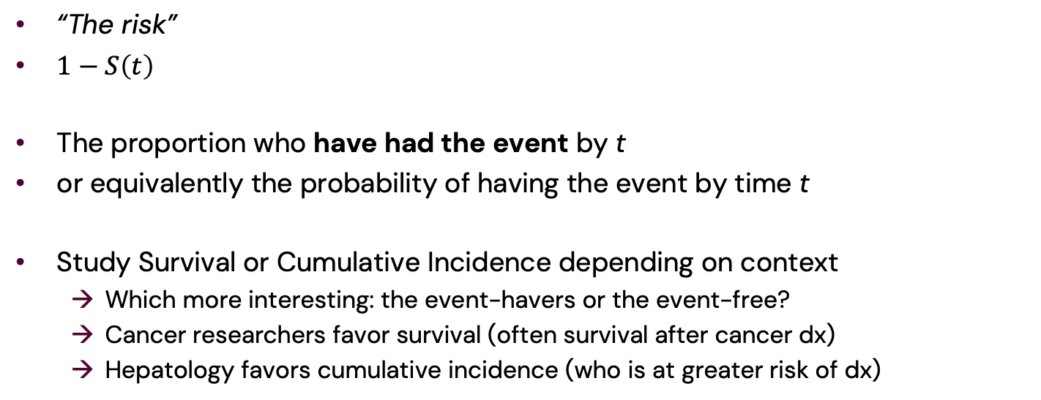
The Cumulative Incidence Function
“The risk”
$1−S\left(t\right)$
The proportion who have had the event by t
or equivalently the probability of having the event by time t
Study Survival or Cumulative Incidence depending on context
Which more interesting: the event-havers or the event-free?
Cancer researchers favor survival (often survival after cancer dx)
Hepatology favors cumulative incidence (who is at greater risk of dx)

Slide 29
The Hazard Rate

Slide 30
Different View: Transition Between States
Subject starts in one state and at some timepoint moves to a different state
We study the transition (the arrow)
S(t) is the proportion still in the 1st state at time t
Alive
Dead
Healthy
Sick

Slide 31

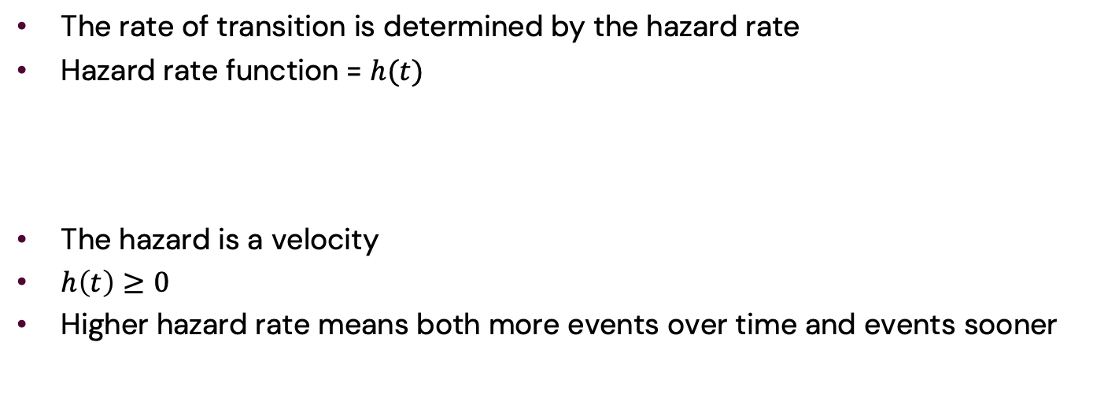
The Hazard Rate
The rate of transition is determined by the hazard rate
Hazard rate function = $h(t)$
The hazard is a velocity
$h\left(t\right)≥0$
Higher hazard rate means both more events over time and events sooner
Healthy
$$h(t)$$
Sick

Slide 32

Hazard function examples
The Hazard function can look very different depending on the mechanics of the transition
$$h(t)$$
Time

Slide 33
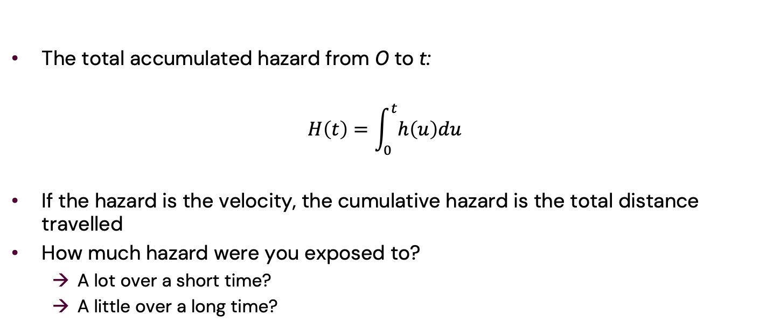
The Cumulative Hazard
The total accumulated hazard from 0 to t:
$$H\left(t\right)=\int_{0}^{t}{h\left(u\right)du}$$
If the hazard is the velocity, the cumulative hazard is the total distance travelled
How much hazard were you exposed to?
A lot over a short time?
A little over a long time?

Slide 34
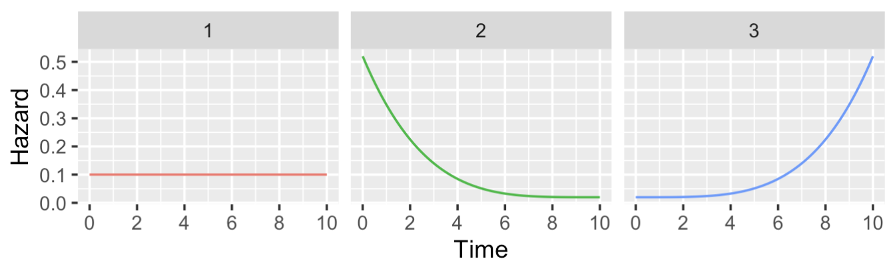
Hazard & Survival
How is the hazard function related to the survival function?

Slide 35
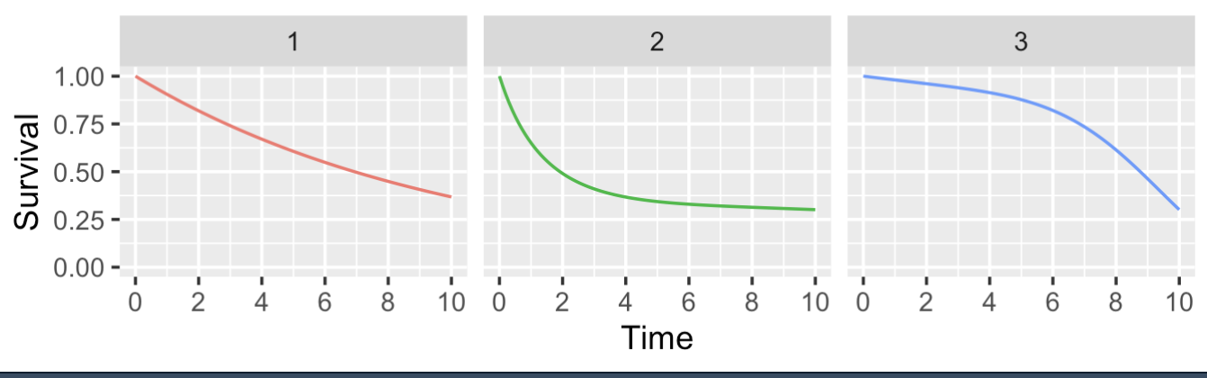
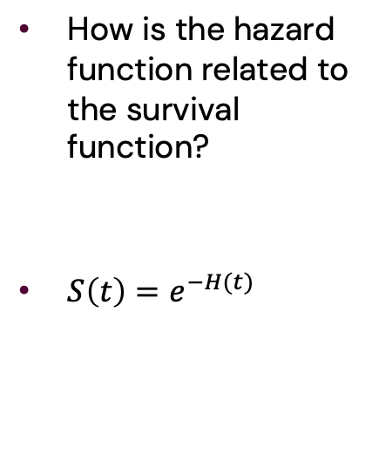
Hazard & Survival
How is the hazard function related to the survival function?
$S\left(t\right)=e^{−H(t)}$

Slide 36
Two Measures of Interest
When doing survival analysis, we want to study two quantities:
The Survival (or Cumulative Incidence) over time for interesting comparisons
More practical outcome
e.g. comparison after 5 years
treatment vs. no treatment
by smoking and age group (4 comparisons)
The Hazard function
Useful scale for exposure
e.g. carcinogens for developing cancer

Slide 37
Cox Proportional Hazards Regression

Slide 38
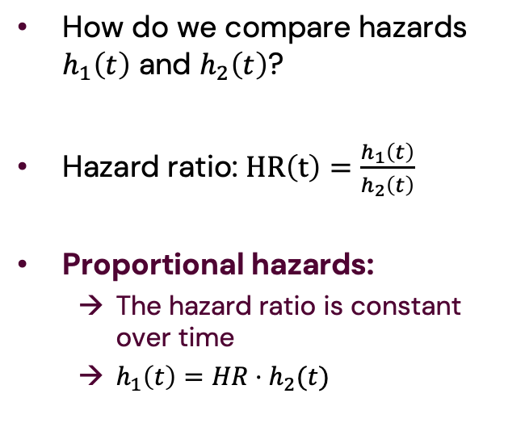
Proportional Hazards
How do we compare hazards $h_{1}\left(t\right)$ and $h_{2}\left(t\right)$?
Hazard ratio: $HR\left(t\right)=\frac{h_{1}\left(t\right)}{h_{2}\left(t\right)}$
Proportional hazards:
The hazard ratio is constant over time
$h_{1}\left(t\right)=HR⋅h_{2}(t)$

Slide 39
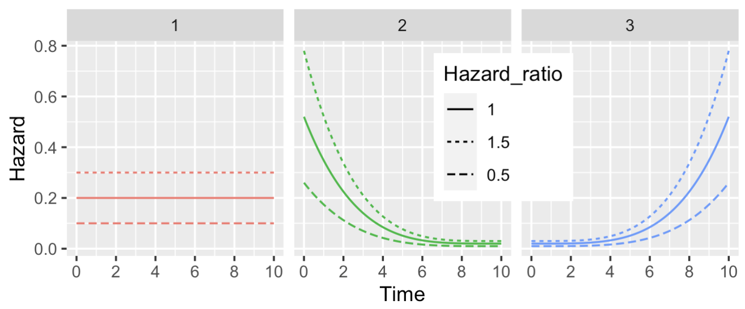
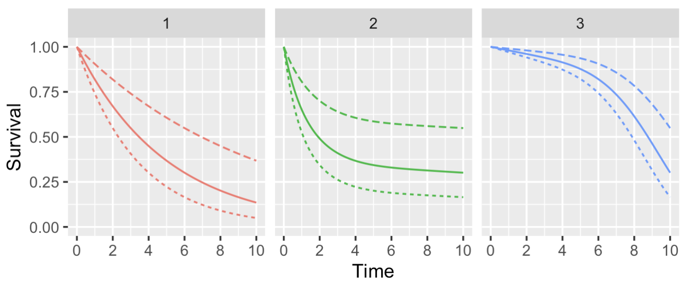
Proportional Hazards
How do we compare hazards $h_{1}\left(t\right)$ and $h_{2}\left(t\right)$?
Hazard ratio: $HR\left(t\right)=\frac{h_{1}\left(t\right)}{h_{2}\left(t\right)}$
Proportional hazards:
The hazard ratio is constant over time
$h_{1}\left(t\right)=HR⋅h_{2}(t)$

Slide 40
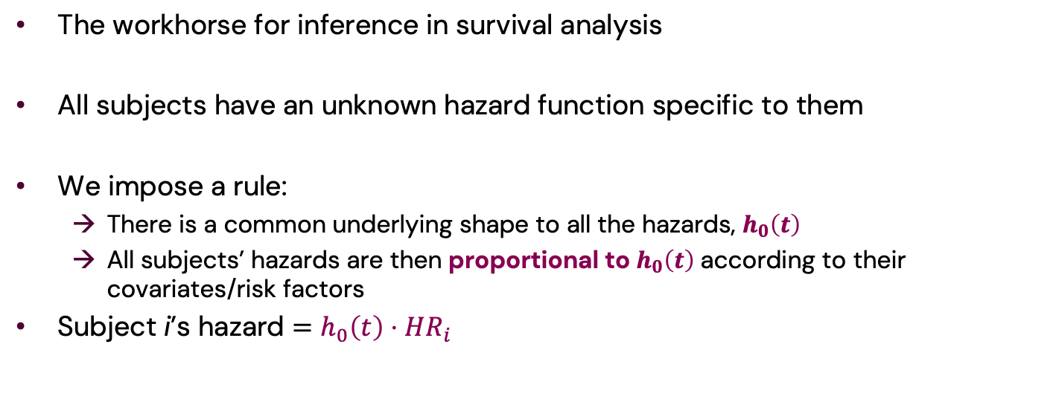
Cox Proportional Hazards Regression Models
The workhorse for inference in survival analysis
All subjects have an unknown hazard function specific to them
We impose a rule:
There is a common underlying shape to all the hazards, $h_{0}\left(t\right)$
All subjects’ hazards are then proportional to $h_{0}\left(t\right)$ according to their covariates/risk factors
Subject i’s hazard $=h_{0}\left(t\right)⋅HR_{i}$

Slide 41
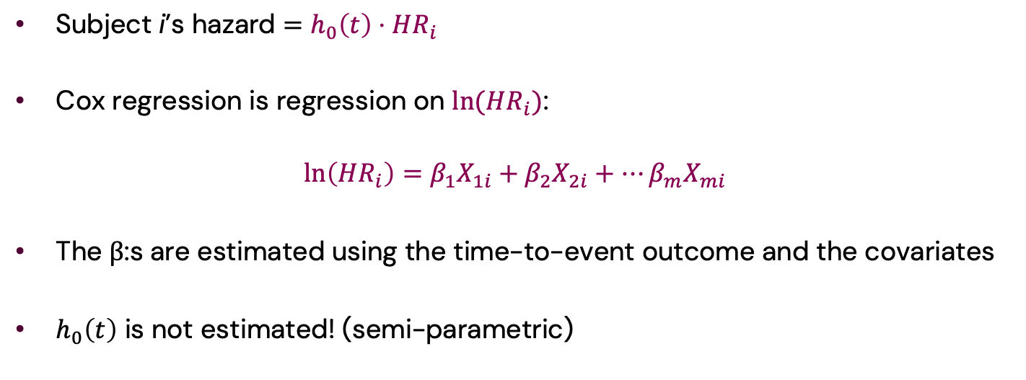
Cox Proportional Hazards Regression Models (2)
Subject i’s hazard $=h_{0}\left(t\right)⋅HR_{i}$
Cox regression is regression on $ln(HR_{i})$:
$$\ln\left(HR_{i}\right)=β_{1}X_{1i}+β_{2}X_{2i}+…β_{m}X_{mi}$$
The β:s are estimated using the time-to-event outcome and the covariates
$h_{0}\left(t\right)$ is not estimated! (semi-parametric)

Slide 42
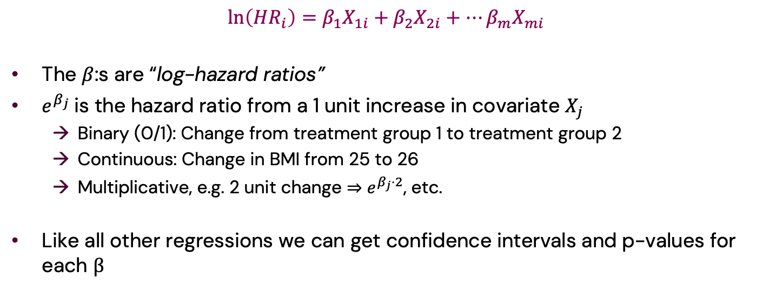
Interpreting Cox Models
$$\ln\left(HR_{i}\right)=β_{1}X_{1i}+β_{2}X_{2i}+…β_{m}X_{mi}$$
The $β$:s are “log-hazard ratios”
$e^{β_{j}}$is the hazard ratio from a 1 unit increase in covariate $X_{j}$
Binary (0/1): Change from treatment group 1 to treatment group 2
Continuous: Change in BMI from 25 to 26
Multiplicative, e.g. 2 unit change ⇒ $e^{β_{j}⋅2}$, etc.
Like all other regressions we can get confidence intervals and p-values for each β

Slide 43
Example: Primary Biliary Cholangitis & Death
PBC: Autoimmune disease destroying the bile ducts in the liver
Causes scarring (fibrosis) ⟹ Cirrhosis ⟹ Liver failure ⟹ Death
What is your prognosis based on current fibrosis stage (1-4)?
412 PBC patients from the Mayo clinic
Stage 1+2: 113 Stage 3: 155 Stage 4 (cirrhosis): 144
182 died or underwent liver transplant over up to 12 years (median 5 years)
data(“pbc”, package=“survival”) in R

Slide 44
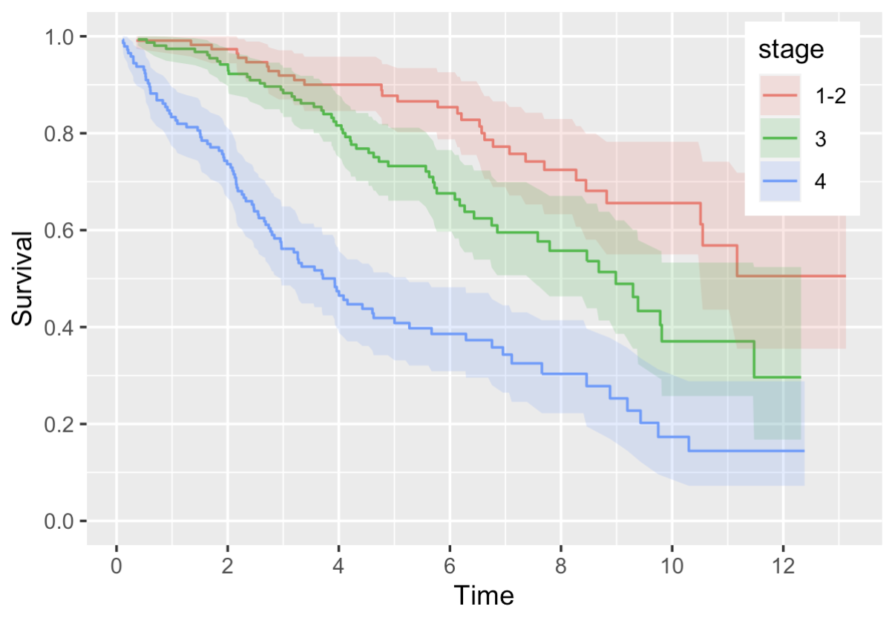
Example: Primary Biliary Cholangitis & Death (2)
Kaplan-Meier curves:
Can do log-rank test, but…
Age is potential confounder!
risk of death
fibrosis progression (time)
Overall quantification of the difference
Cox regression let’s us do all this and test for differences between stages

Slide 45

Example: Primary Biliary Cholangitis & Death (3)
Cox model: $\ln\left(HR\right)=β_{1}\left[age\right]+β_{2}\left[sex (f)\right]+ β_{3}\left[stage 3\right]+β_{4}\left[stage 4\right]$
Estimates: Hazard Ratios: Significance tests:

Slide 46

Example: Primary Biliary Cholangitis & Death (3)
Stage 1-2:
Cox model: $\ln\left(HR\right)=β_{1}\left[age\right]+β_{2}\left[sex (f)\right]+ β_{3}⋅0+β_{4}⋅0$
Estimates: Hazard Ratios: Significance tests:

Slide 47

Example: Primary Biliary Cholangitis & Death (3)
Stage 3:
Cox model: $\ln\left(HR\right)=β_{1}\left[age\right]+β_{2}\left[sex (f)\right]+ β_{3}⋅1+β_{4}⋅0$
Estimates: Hazard Ratios: Significance tests:

Slide 48

Example: Primary Biliary Cholangitis & Death (3)
Stage 4:
Cox model: $\ln\left(HR\right)=β_{1}\left[age\right]+β_{2}\left[sex (f)\right]+ β_{3}⋅0+β_{4}⋅1$
Estimates: Hazard Ratios: Significance tests:

Slide 49
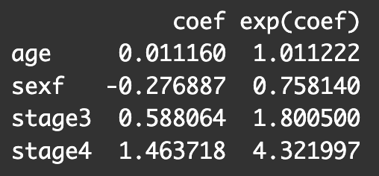
Example: Primary Biliary Cholangitis & Death (3)
Cox model: $\ln\left(HR\right)=β_{1}\left[age\right]+β_{2}\left[sex (f)\right]+ β_{3}\left[stage 3\right]+β_{4}\left[stage 4\right]$
Estimates: Hazard Ratios: Significance tests:

Slide 50
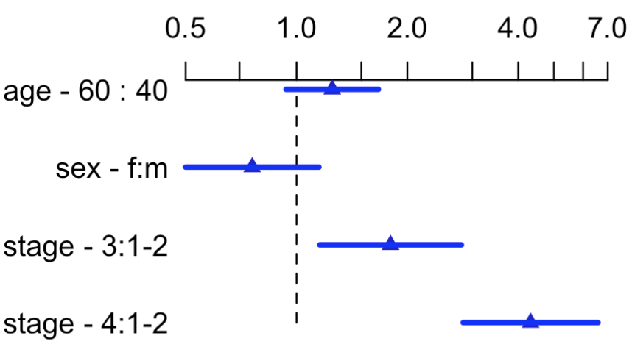
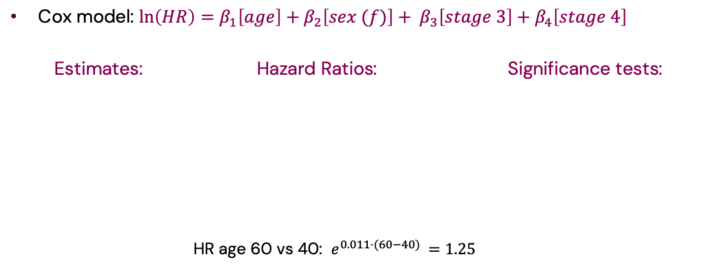
Example: Primary Biliary Cholangitis & Death (3)
Cox model: $\ln\left(HR\right)=β_{1}\left[age\right]+β_{2}\left[sex (f)\right]+ β_{3}\left[stage 3\right]+β_{4}\left[stage 4\right]$
Estimates: Hazard Ratios: Significance tests:
HR age 60 vs 40: $e^{0.011⋅(60−40) }=1.25$

Slide 51
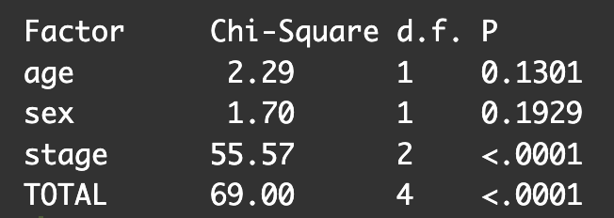
Example: Primary Biliary Cholangitis & Death (3)
Cox model: $\ln\left(HR\right)=β_{1}\left[age\right]+β_{2}\left[sex (f)\right]+ β_{3}\left[stage 3\right]+β_{4}\left[stage 4\right]$
Estimates: Hazard Ratios: Significance tests:
HR age 60 vs 40: $e^{0.011⋅(60−40) }=1.25$

Slide 52
Checking the Proportional Hazards Assumption
Do the curves look like they have proportional hazards?

Slide 53
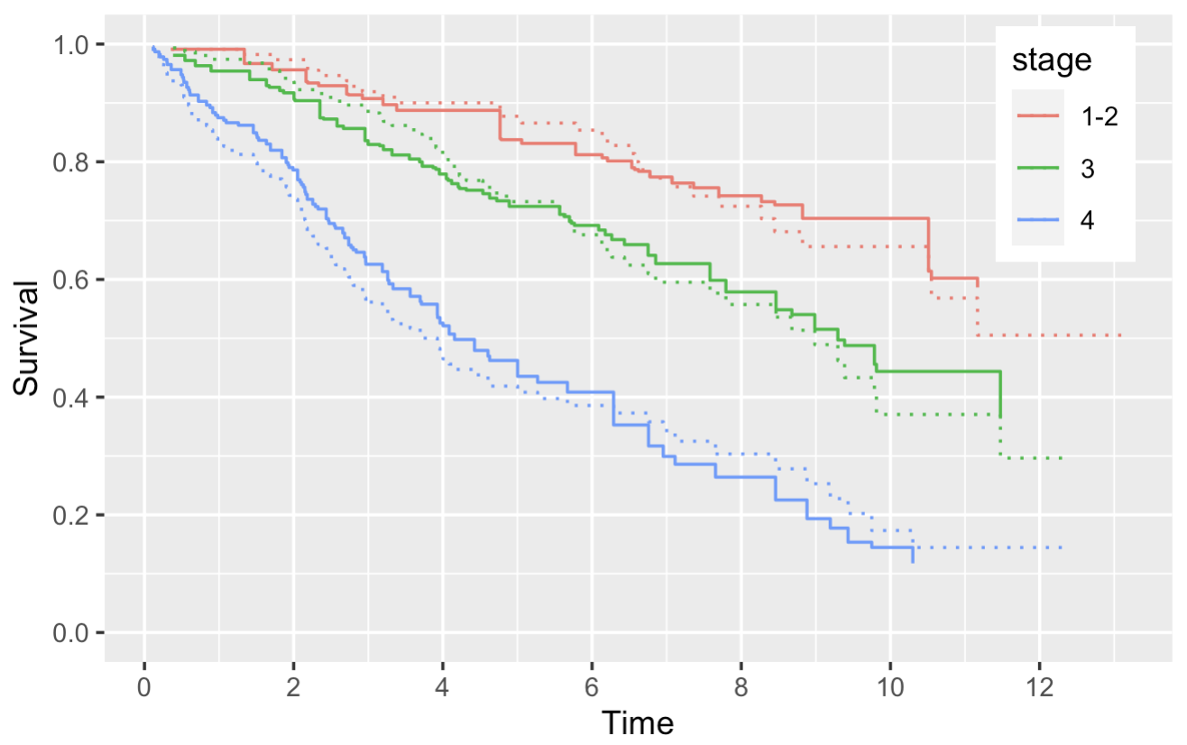
Checking the Proportional Hazards Assumption
Do the curves look like they have proportional hazards?
If they did, according to the Cox model:
Important to check!
What to do?
Flexible parametric survival model

